Slide 1
递归树
Xu Yanyan

Slide 2
递归算法的时间复杂度分析
Recurrence relation
Recursion tree

Slide 3
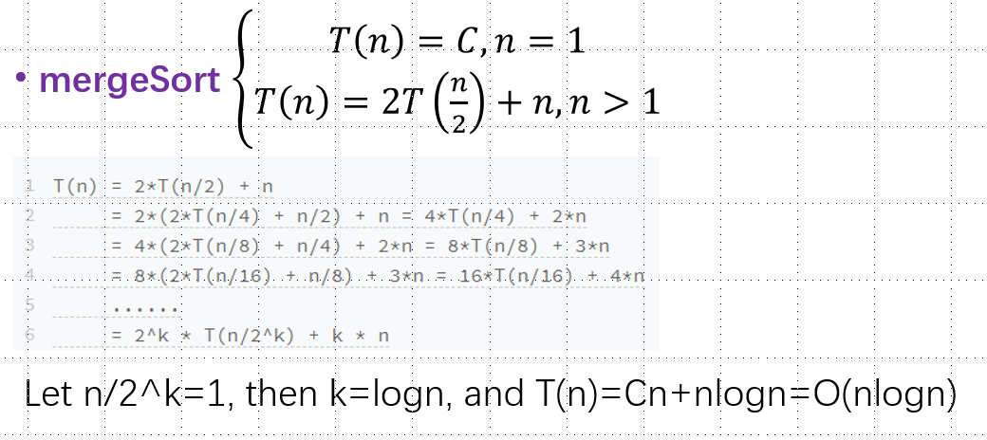
Recurrence relation
Sometimes, recurrence relation is very complicated. (Using recursion tree)

Slide 4
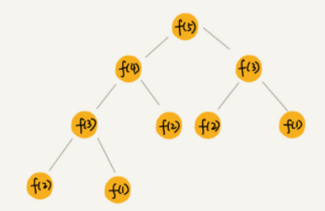
Recursion tree
recurrence relation: f(n)=f(n-1)+f(n-2)
The recursion tree of the Fibonacci sequence

Slide 5
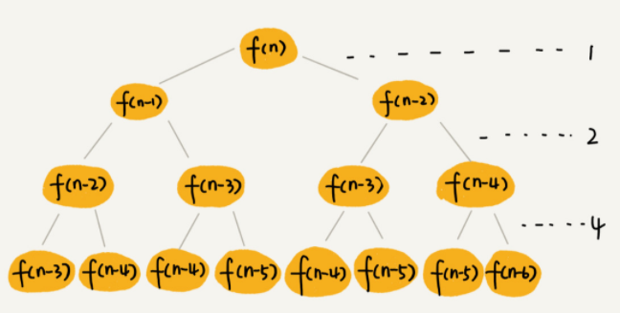








The recursion tree of the Fibonacci sequence
$$−1$$
$$−2$$
$$O(2n)$$
$$the longest path n$$
$$the shortest path \frac{n}{2}$$
$$O(2^{\frac{n}{2}})$$

Slide 6
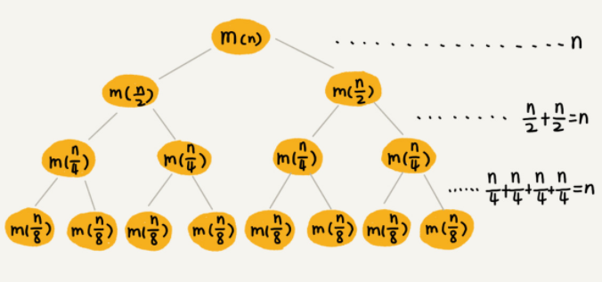
The recursion tree of mergeSort
full binary tree
h=logn
O(n*h)=O(nlogn)

Slide 7
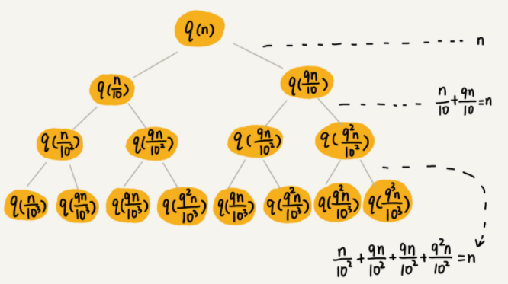


The recursion tree of quicksort Average time complexity
$T\left(n\right)=T\left(\frac{n}{10}\right)+$ $T\left(\frac{9n}{10}\right)$+n, complicated
$n,\frac{n}{10},$ $\frac{n}{102},…,1 →the shortest path h=log10n$
$n,\frac{9n}{10},$ $\frac{92n}{102},…,1 →the longest path h=log\frac{10}{9}n$
O(n*h), h?
h=logn
O(nlogn)

Slide 8
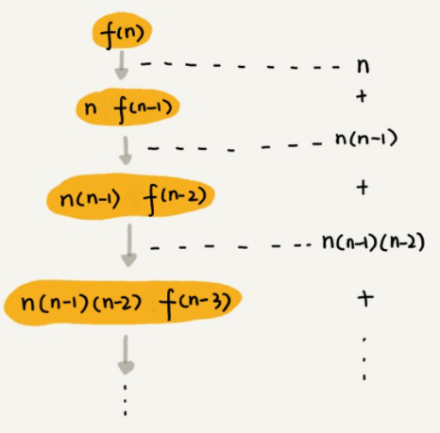

The recursion tree of permutations
$$O\left(n!\right)\sim O(n∗n!)$$

